Slide 1









negative
positive
ROUTINE
CORRESPONDENCE
Week 5
Persuasive

Slide 2






AGENDA
1
2
Effective strategy for writing routine business
requests.
Three common types of routine requests.
3
4
Effective strategy for writing routine replies and
positive messages.
Describe six common types of routine replies and positive
messages.

Slide 3



ROUTINE MESSAGES
A routine request, such as a request for information, is one of the most common kinds of writing.
A request is routine when (1) you are not asking a special favor, and (2) you expect your request to be accepted.
In a routine request, it is not necessary to try to persuade your reader because saying “yes” to your request is a routine part of your reader´s job.

Slide 4




Making requests is a routine part of business, and in most cases your audience will be prepared to comply.
By applying a clear strategy and tailoring your approach to each situation, you’ll be able to generate effective requests quickly.

Slide 5


1
ROUTINE
REQUEST
Opening
Closing
For routine requests and positive
messages
• State the request or main idea
• Give necessary details and justify your request
• Close with a cordial request for
specific action
Body

Slide 6


1
STATING YOUR REQUEST UP FRONT
EXPLAINING AND JUSTIFYING YOUR REQUEST
REQUESTING SPECIFIC ACTION IN A COURTEOUS CLOSE
Effective strategy for writing routine business
requests.

Slide 7
OPENING:
STATING YOUR REQUEST UP FRONT
PAY ATTENTION TO TONE.
ASSUME THAT YOUR AUDIENCE WILL COMPLY.
BE SPECIFIC
Instead of demanding action (“Send me the latest version of
the budget spreadsheet”), show respect by using words such as please and I would
appreciate.
You can generally assume that your readers will comply with routine requests, so you don’t need to devote a lot of time or energy toward trying to convince them to do so.
State precisely what you want. For example, if you request the latest market data from your research department, be sure to say whether you want a 1-page
summary or 100 pages of raw data.

Slide 8
BODY:
EXPLAINING AND JUSTIFYING YOUR
REQUEST
SMOOTH & LOGICAL
READER'S BENEFIT
SCAFFOLDING
The explanation of the request should be a smooth out-growth of the opening statements.
If you have multiple requests or questions, ask the most important questions first and deal with only one topic per question.
If you have an unusual or complex request, break
it down into specific, individual questions so that the reader can address each one sepa-
rately.
If complying with the
request could benefit the reader, be sure to mention that.

Slide 9
CLOSING:
REQUESTING SPECIFIC ACTION IN A COURTEOUS CLOSE
CALL FOR ACTION
CONTACT INFORMATION
SINCERE THANKS
a specific request that includes
any relevant deadlines,
information about how you can be reached
an expression of appreciation or goodwill.

Slide 10
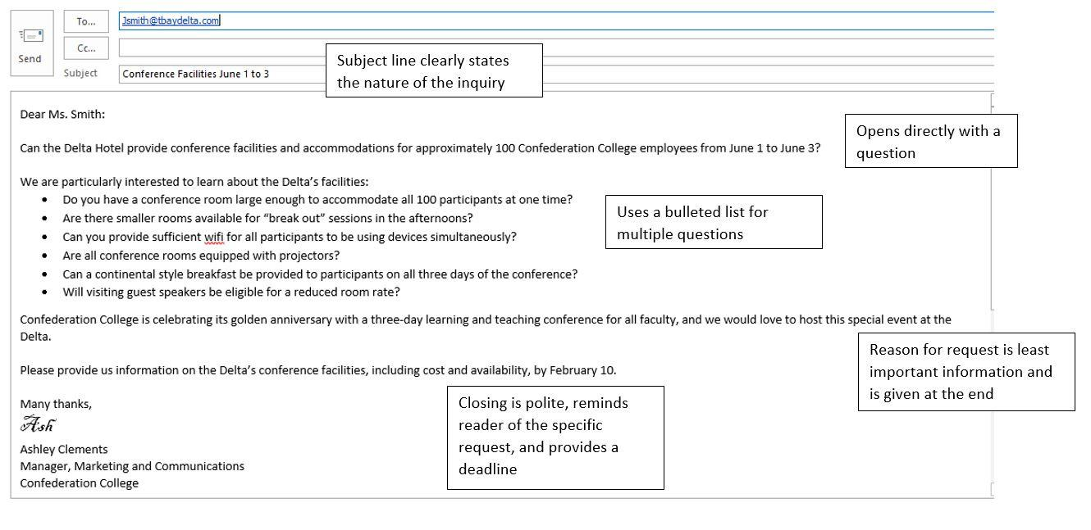

Slide 11
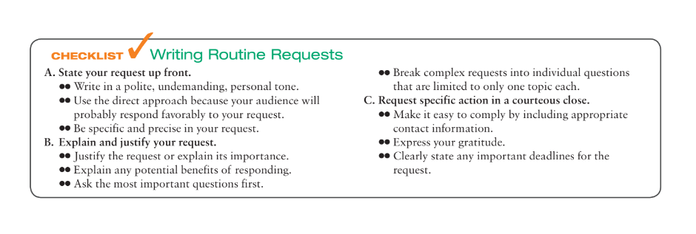
Activity: Write a routine message, requesting your IT team to update the company website by Monday. The request is to add the bios of three new employees hired in the Marketing department along with their pictures and ambitions before the meeting with your new investors.

Slide 12
2
Asking for information or action
Asking for recommendations
Making claims and requesting adjustments.
Three common types of routine requests

Slide 13
2.1
ASKING FOR INFORMATION
Most simple requests can be handled with three message points:
● What you want to know or what you want your readers to do
● Why you’re making the request (not required in all cases)
● Why it may be in your readers’ interests to help you (not applicable in all cases)

Slide 14
2.1
ASKING FOR INFORMATION
In case of complex requests:
You may need to provide more extensive reasons and justification for your request.
If applicable, point out any benefits to the reader of complying with your request.
Naturally, be sure to adapt your request to your audience and the situation

Slide 15
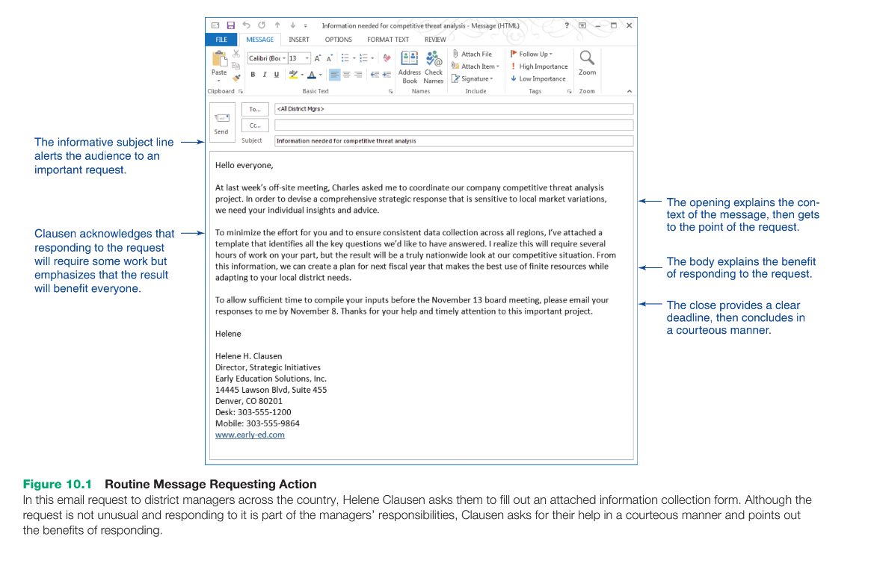

Slide 16
2.2
ASKING FOR RECOMMENDATIONS
Companies ask applicants to list people who can vouch for their ability, skills, integrity, character, and fitness for the job.
Before you volunteer someone’s name as a reference, ask permission.
Requests for recommendations and references are routine, so you can organize your inquiry using the direct approach.

Slide 17
2.2
ASKING FOR RECOMMENDATIONS
Open your message by clearly stating why the recommendation is required (if it’s not for a job, be sure to explain its purpose)
Refresh the memory of any potential reference you haven’t been in touch with for a while.
Close your message with an expression of appreciation and the full name and address (email or physical address) of the person to whom the message should be sent.
When asking for an immediate recommendation, you should also mention the deadline.

Slide 18
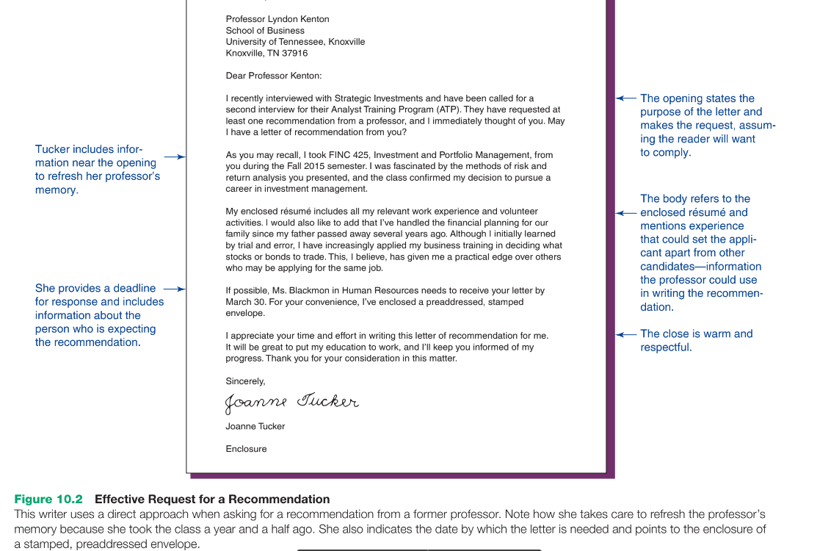

Slide 19
2.3
MAKING CLAIMS & REQUESTING FOR ADJUSTMENTS
When writing a claim or requesting an adjustment:
• Explain the problem and give
details
• Provide backup information (any information the recipient needs to verify your complaint.)
• Request specific action (politely request specific action or
convey a sincere desire to find a solution.)

Slide 20
2.3
MAKING CLAIMS & REQUESTING FOR ADJUSTMENTS
if appropriate, suggest that the business
relationship will continue if the problem is solved satisfactorily. Be prepared to back up
your claim with invoices, sales receipts, canceled checks, dated correspondence, and any
other relevant documents. Send copies and keep the originals for your files.

Slide 21
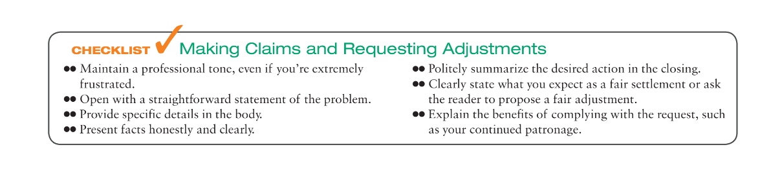

Slide 22
3
STARTING WITH THE MAIN IDEA
PROVIDING NECESSARY DETAILS AND EXPLANATION
ENDING WITH A COURTEOUS CLOSE
Effective strategy for writing routine replies and positive messages.

Slide 23
3.1
STARTING WITH THE MAIN IDEA
Begin with a positive note or a good news, that prepares audience for the next details.
Make your opening clear and concise.
State the single most important idea that you have for the audience.

Slide 24
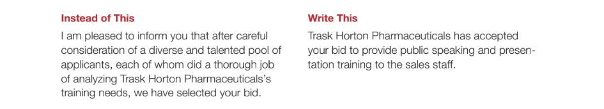

Slide 25
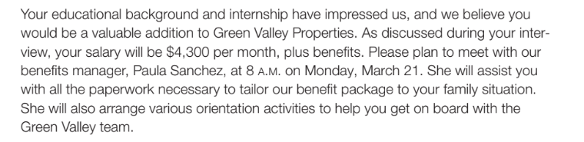
3.2
PROVIDING NECESSARY DETAILS AND EXPLANATION
Maintain the positive tone that you begin with.
The tone is easy to maintain when the message is entirely positive.

Slide 26
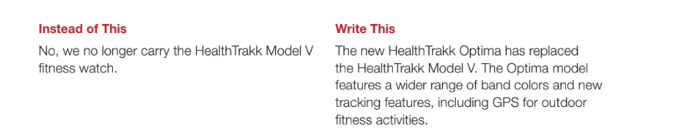
3.2
PROVIDING NECESSARY DETAILS AND EXPLANATION
if your routine message is mixed and must convey mildly disappointing information,
put the negative portion of your message into as favorable a context as possible
Notes:
In this example, the more complete description is less negative and emphasizes how the
recipient can benefit from the change.

Slide 27
3.3
SENDING WITH A COURTEOUS CLOSE
Make sure audience members understand what to do next
How that action will benefit them (if applicable).

Slide 28
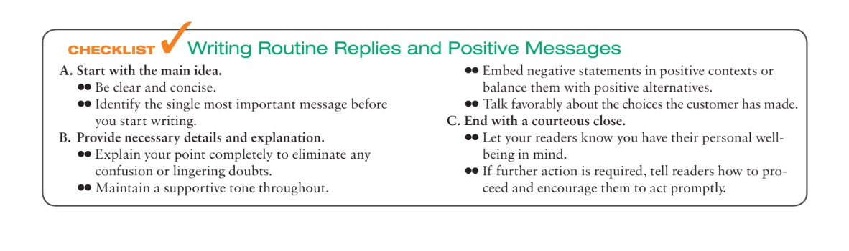

Slide 29
4
ANSWERING REQUESTS FOR INFORMATION AND ACTION
GRANTING CLAIMS AND REQUESTS FOR ADJUSTMENT
PROVIDING RECOMMENDATIONS AND REFERENCES
SHARING ROUTINE INFORMATION
ANNOUNCING GOOD NEWS
FOSTERING GOODWILL
Six common types
of routine replies and positive
messages.

Slide 30
4.1
ANSWERING REQUESTS FOR INFORMATION AND ACTION
When you’re answering requests and a potential sale is involved, you have three main goals:
(1) to respond to the inquiry and answer all questions,
(2) to leave your reader with a good impression of you and your firm, and (3) to encourage the future sale.

Slide 31
4.2
GRANTING CLAIMS AND REQUESTS FOR ADJUSTMENT
Responding to mistakes in a courteous, reader-focused way
helps repair important business relationships.
Decide according to your company’s policies for resolving such issues.
In general, take the following steps:
Acknowledge receipt of the customer’s claim or complaint.
Sympathize with the customer’s inconvenience or frustration.
Take (or assign) personal responsibility for setting matters straight.
Explain precisely how you have resolved, or plan to resolve, the situation.
Take steps to repair the relationship.
Follow up to verify that your response was correct.

Slide 32
4.3
PROVIDING RECOMMENDATIONS AND REFERENCES
A successful recommendation letter contains a number of relevant details;
The candidate’s full name
The position or other objective the candidate is seeking
The nature of your relationship with the candidate
Facts and evidence relevant to the candidate and the opportunity
A comparison of this candidate’s potential with that of peers, if available (for example, “Ms. Jonasson consistently ranked in the top 10 percent of our national sales force.”)
Your overall evaluation of the candidate’s suitability for the opportunity

Slide 33
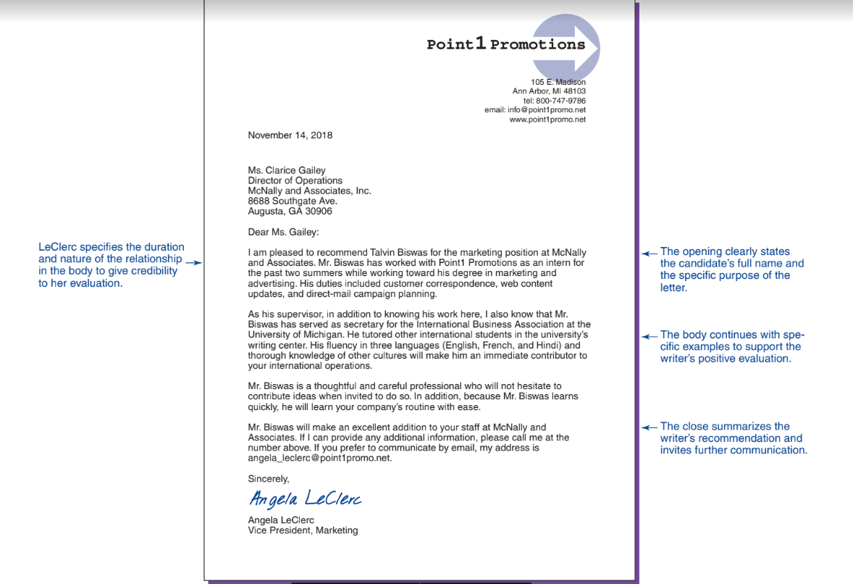

Slide 34
4.4
SHARING ROUTINE INFORMATION
When sharing routine
information
• State the purpose at the beginning and briefly mention the nature of the information you are providing
• Provide the necessary details
• End with a courteous close

Slide 35
4.5
ANNOUNCING GOOD NEWS
External good-news announcements are often communicated in a news release
The content follows the customary pattern for a positive message: good news followed by details and a positive close.
direct-to-consumer news releases/ social media releases includes ready-to-share content that is easy to reuse in blog posts, tweets and other social media formats.

Slide 36


Slide 37
4.6
FOSTERING GOODWILL
Goodwill is the positive feeling that encourages people to maintain a business relationship.
Sending congratulations
Sending message for appreciation
Offering condolence

Slide 38
Thank you!
Bovee, C., & Thill, J. (2017, January 4). Business Communication Today (14th ed.). Pearson.

